Slide 1


Final Year Project
FITNESSSTAN
Supervised By: Muhammad Islam (Lecturer)

Slide 2
Project Team
Obaid-Ullah(35739)
Zain Ul Abideen (35515)

Slide 3
INTRODUCTION

Slide 4
Introduction
Fitnessstan is an AI-powered web platform that provides personalized fitness solutions for health-conscious individuals, including those managing conditions like obesity. By integrating tailored workout and diet recommendations, the platform ensures a balanced and comprehensive approach to achieving fitness goals. Its user-friendly design and accessibility aim to make fitness achievable for everyone.

Slide 5
Literature Review

Slide 6
Literature Review [1/4]
There's been a substantial increase in the usage of fitness platforms using AI, with an annual growth rate of 17%. [1]
Importance of Nutrition in Fitness:
Studies suggest that a balanced intake of carbohydrates, proteins, and fats is crucial for optimizing workout results [2] [3]
Combining a structured workout plan with a tailored diet plan can lead to better fitness outcomes.
[1] https://www.solutelabs.com/blog/future-of-fitness
[2] https://www.healthline.com/nutrition/workout-routine-for-men
[3] https://www.puregym.com/blog/the-best-gym-workout-plan-for-gaining-muscle/

Slide 7
Literature Review [2/4]
Resting Energy Expenditure (REE) [1]
It represents the energy required by the body to maintain essential physiological functions while at rest.
These equations typically consider factors such as weight, height, age, and gender.
The Mifflin-St Jeor equation for males is: [1]
REE=10×weight kg +6.25×height cm −5×age y +5
The Mifflin-St Jeor equation for females is: [1]
REE=10×weight kg +6.25×height cm −5×age y −161
[1] https://pubmed.ncbi.nlm.nih.gov/2305711/

Slide 8
Literature Review [3/4]
Total Daily Energy Expenditure (TDEE) [1]
the total number of calories that your body burns in a day, encompassing all activities and physiological functions
TDEE is crucial for weight management [1]
Sedentary (little or no exercise): REE × 1.2
Lightly active (sports 1-3 days/week): REE × 1.375
Moderately active (sports 3-5 days/week): REE × 1.55
Very active (sports 6-7 days a week): REE × 1.725
Extra active (very hard exercise, training twice a day): REE × 1.9
[1] https://pubmed.ncbi.nlm.nih.gov/16020440/

Slide 9
Literature Review [4/4]
Weight loss [1]
At moderate Pace: Calories Intake=TDEE−500
At faster Pace: Calories Intake=TDEE−1000
Weight Gain [1]
At moderate Pace: Calories Intake=TDEE+500
At faster Pace: Calories Intake=TDEE+1000
Maintenance [1]
Calories Intake=TDEE
[1] https://pubmed.ncbi.nlm.nih.gov/16020440/

Slide 10
PROBLEM STATEMENT

Slide 11
Problem Statement
Obesity individuals face significant challenges in maintaining their diet effectively. Existing platform only focus on exercise and struggles in giving personalized diet plan. Existing platform do not recommend diet along with exercises If they do they bound people with specific food item, which is difficult for people to have on regular basis. They do not provide personalized diet plans according to user needs.

Slide 12
Methodology And Proposed Solution

Slide 13
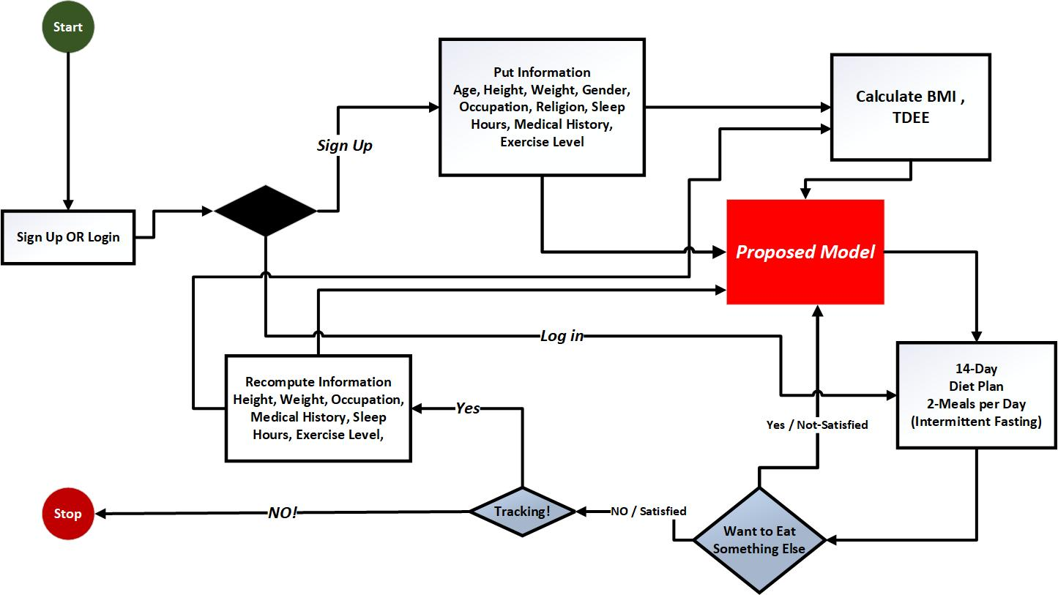
Methodology

Slide 14
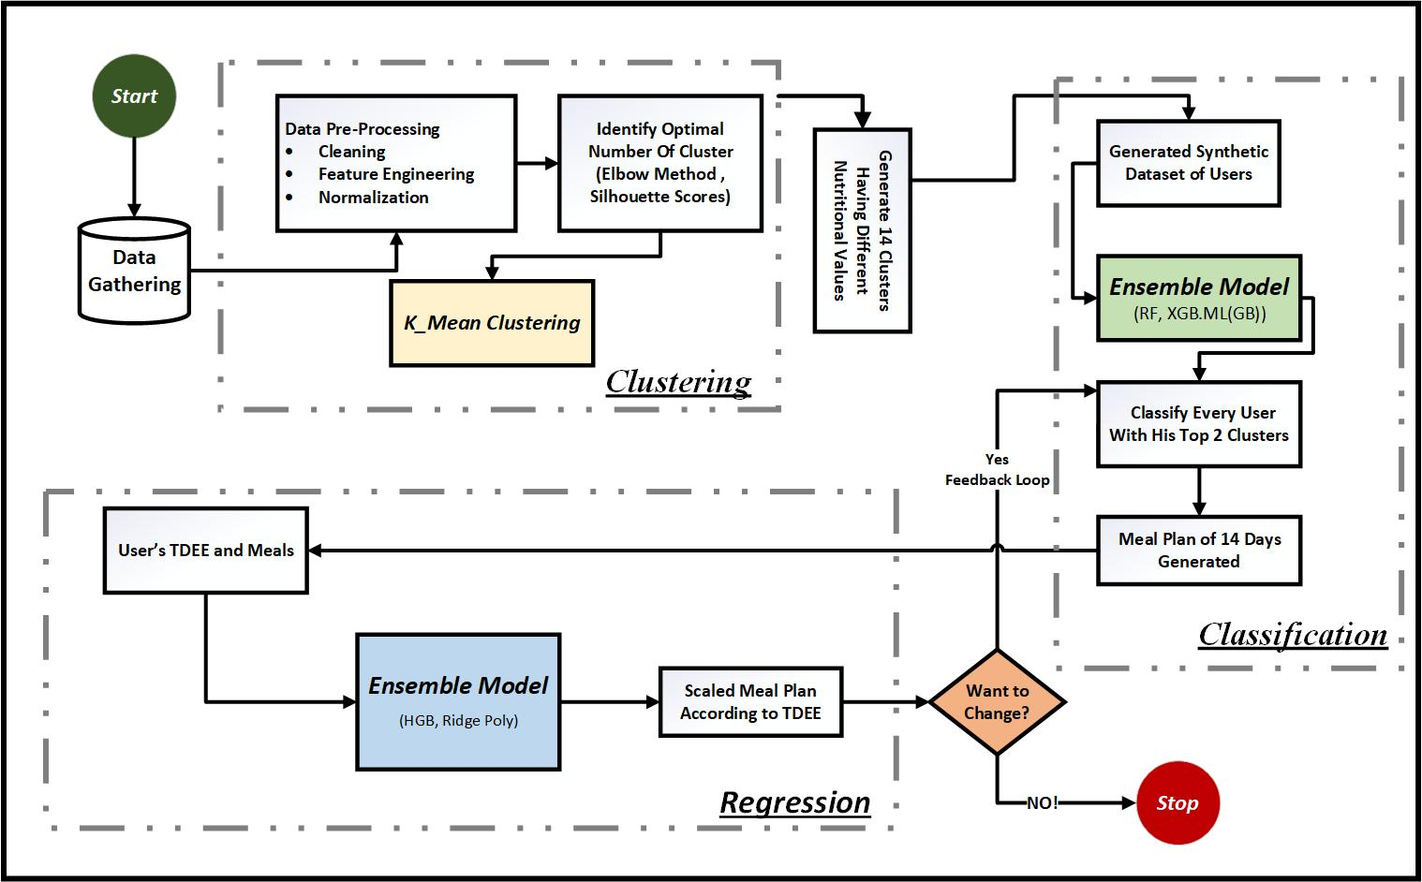
Proposed Solution

Slide 15


